Slide 1
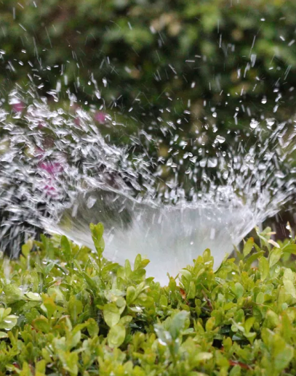
Smart Irrigation System
Presented by:
Sayali Kudale

Slide 2
Project Overview and Scope
User control Irrigation
Location based rain forecast
Give full control to user to start/stop irrigation process
Set/update threshold values and Irrigation time.
Advanced weather sensing to detect the irrigation needs based on probability of rain.
Automatic Irrigation
Monitoring of moisture level and weather
Monitor the moisture content of the soil.
Automatically start the irrigation process when moisture content is below threshold value.
Allow user to monitor the moisture level of the plants and weather condition in their location.

Slide 3
Comparison with existing work
Smart Irrigation for efficient water use[1]
Energy saving automated system for Plants [2]
Implemented solar powered wireless sensor network system.
IoT resources used for monitoring and data storing purpose.
Arduino and IoT based automatic water system for plants.
No remote monitoring and controlling available.
Smart Irrigation System Using IOT And Raspberry Pi [3]
Indoor plant monitoring System using NodeMCU[4]
This Raspberry pi based system monitors the temperature, humidity and moisture in the field. Also gives webcam monitoring.
Manual control of the system is not available.
Moisture, humidity, temperature and light intensity monitoring using android app. Also provides SMS notification and advances chatbot support using AlexNet model.
Web based Smart Irrigation using Raspberry pi [5]
Simple Indoor Environmental Monitoring System for Houseplant using Web and Mobile Applications [6]
Moisture, humidity, temperature monitoring in php based application using Arduino and Raspberry pi.
No user control, weather information, email/sms notification.
Advance UI to monitor the plant temperature, humidity
No user control, weather information, email/sms notification.

Slide 4

Comparison with existing work
 | Comparison of features available in current systems and proposed system
 | Current systems | Proposed System
Constant monitoring of soil moisture
Temperature, humidity Details
GUI for user
Manual Irrigation Process
Configurable threshold values
Webcam monitoring
Irrigation schedule changes based on rain forecast
Indoor + Outdoor plant support
Deep learning technology

Slide 5
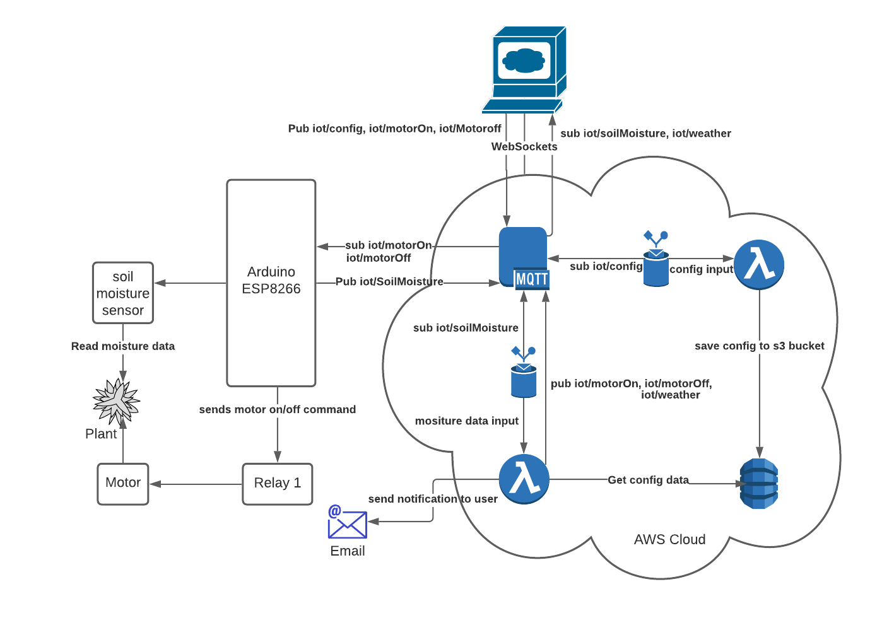
Project Design

Slide 6
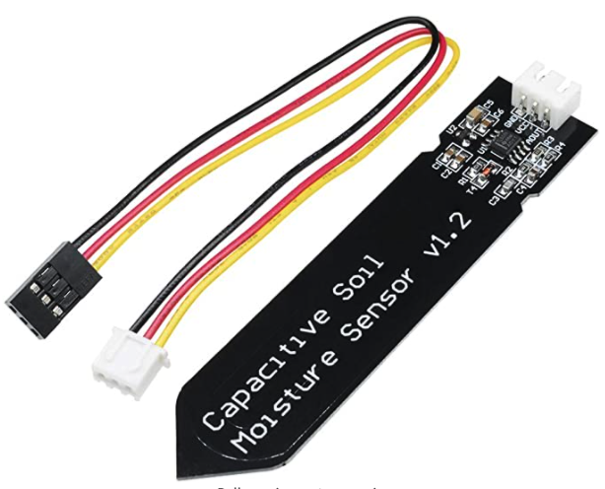
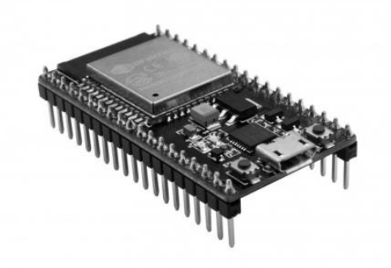
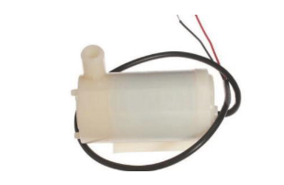
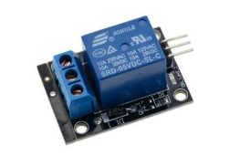
Implementation
Hardware Used:
ESP 8266 is chip-based affordable microcontroller can be easily used with AWS IoT
Capacitive soil sensor is used to read the soil moisture level.
Water pump is used as actuator of the system
Relay is electrically operated switch used to on/off motor
ESP 8266 microcontroller
Capacitive soil sensors
Challenges:
Soil Moisture Sensors are prone to corrosion.
Raspberry pi not able to read the analog signals directly and is not cost effective
Solutions:
Use of Capacitive soil moisture sensors.
ESP 8266 is cost effective and can read analog input by sensors.
Mini DC water pump
Relay

Slide 7
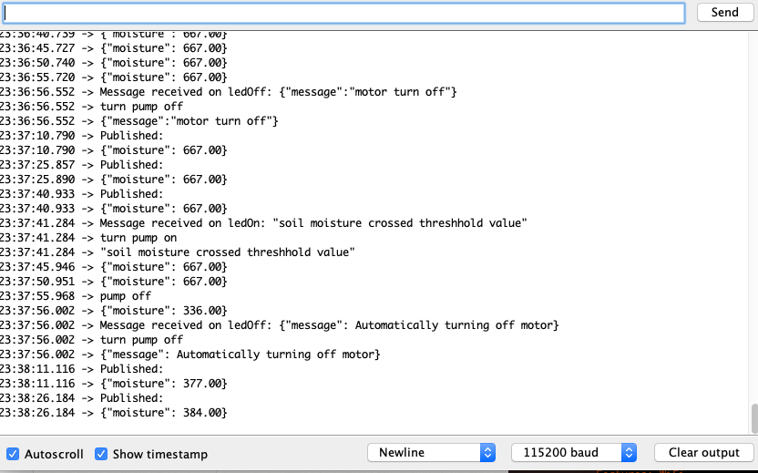
Implementation
Arduino IDE
Read and publish the moisture data.
Subscribe to motor on/off commands and pass signal to relay
When motor is on monitor the moisture and automatically turn off motor when soil moisture reaches threshold value.
Challenges:
Arduino IDE was not able to detect the Arduino device on Mac OS via USB port.
Solutions:
Installed the additional SiLabsUSBDriver.

Slide 8
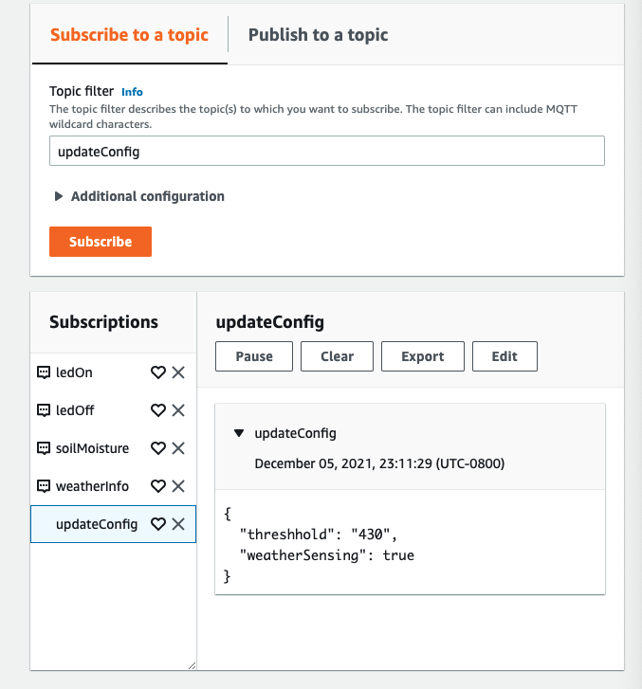
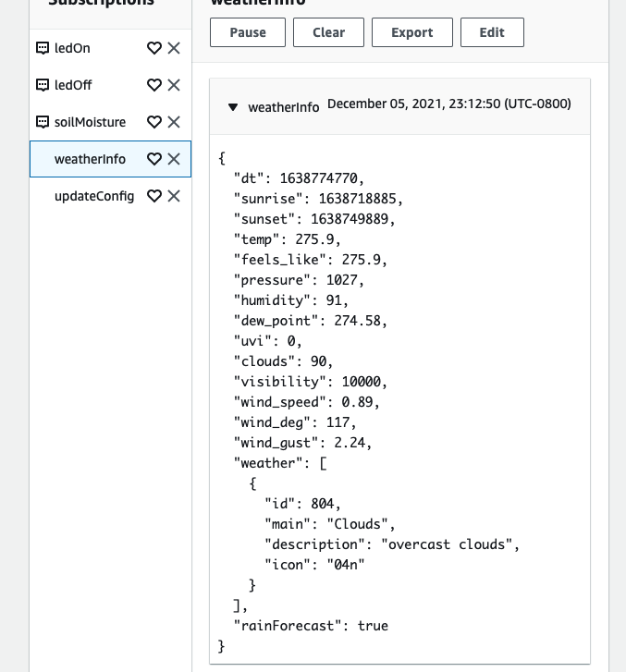
Implementation
AWS MQTT Topics
updateConfig
weatherInfo
soilMoisture
ledOn
ledOff
Challenges:
Periodically forecast the weather information.
Capture the user configurations.
Solutions:
Call openweathermap.org apis from lambda with event source as mqtt topic.
Save configurations into S3 from lambda function with event source as mqtt topic.

Slide 9
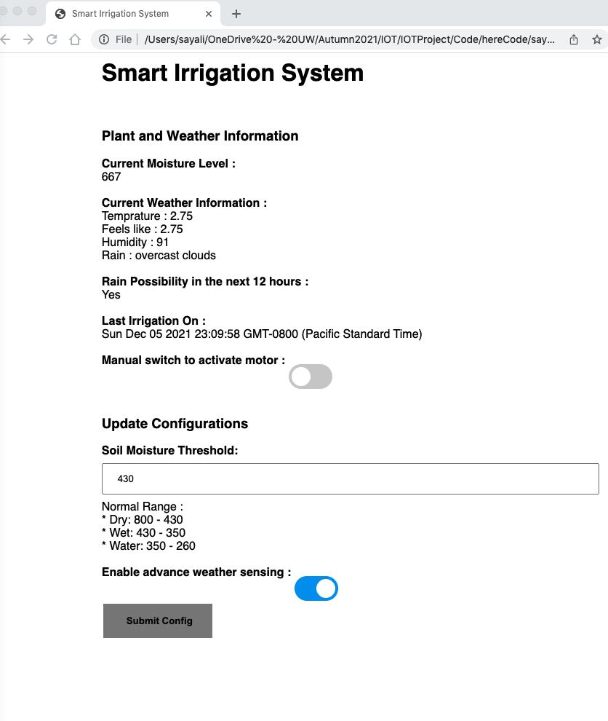
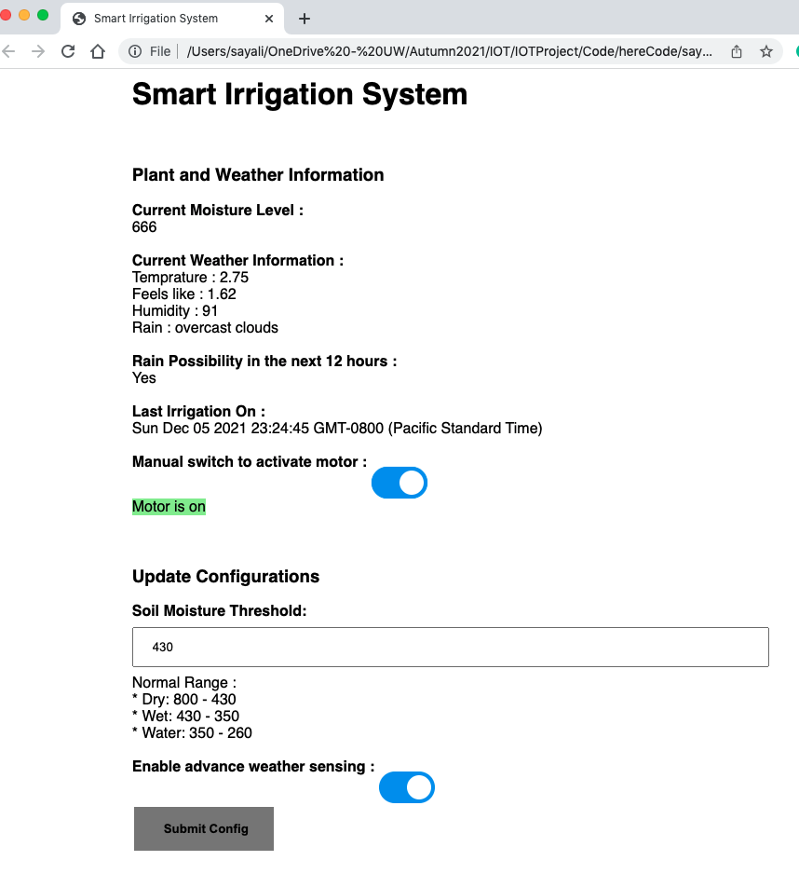
Implementation
Web UI
Monitor the soil moisture level
Monitor the weather data and rain possibility.
Manually turn the motor on/ off
Update the soil moisture threshold
Disable/Enable advance weather sensing.
Challenges:
Communicate with AWS IoT Core and ESP module from web.
Generate AWS endpoint by using AWS secret key and access Id.
Solutions:
Use websockets in javascript and html by using Paho mqtt library.
Add crypto libraries to perform SHA-256 hash functions to generate advance cryptography information used by AWS.

Slide 10
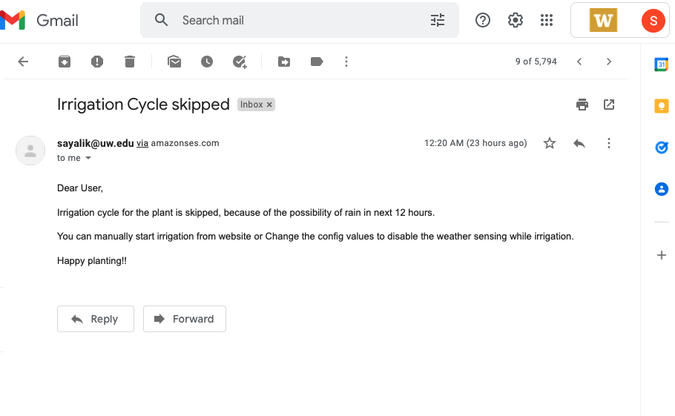
Implementation
Email Notification
User receives email notification whenever irrigation cycle is skipped due to possibility of rain in next 12 hour.

Slide 11

Demo
Link Here

Slide 12
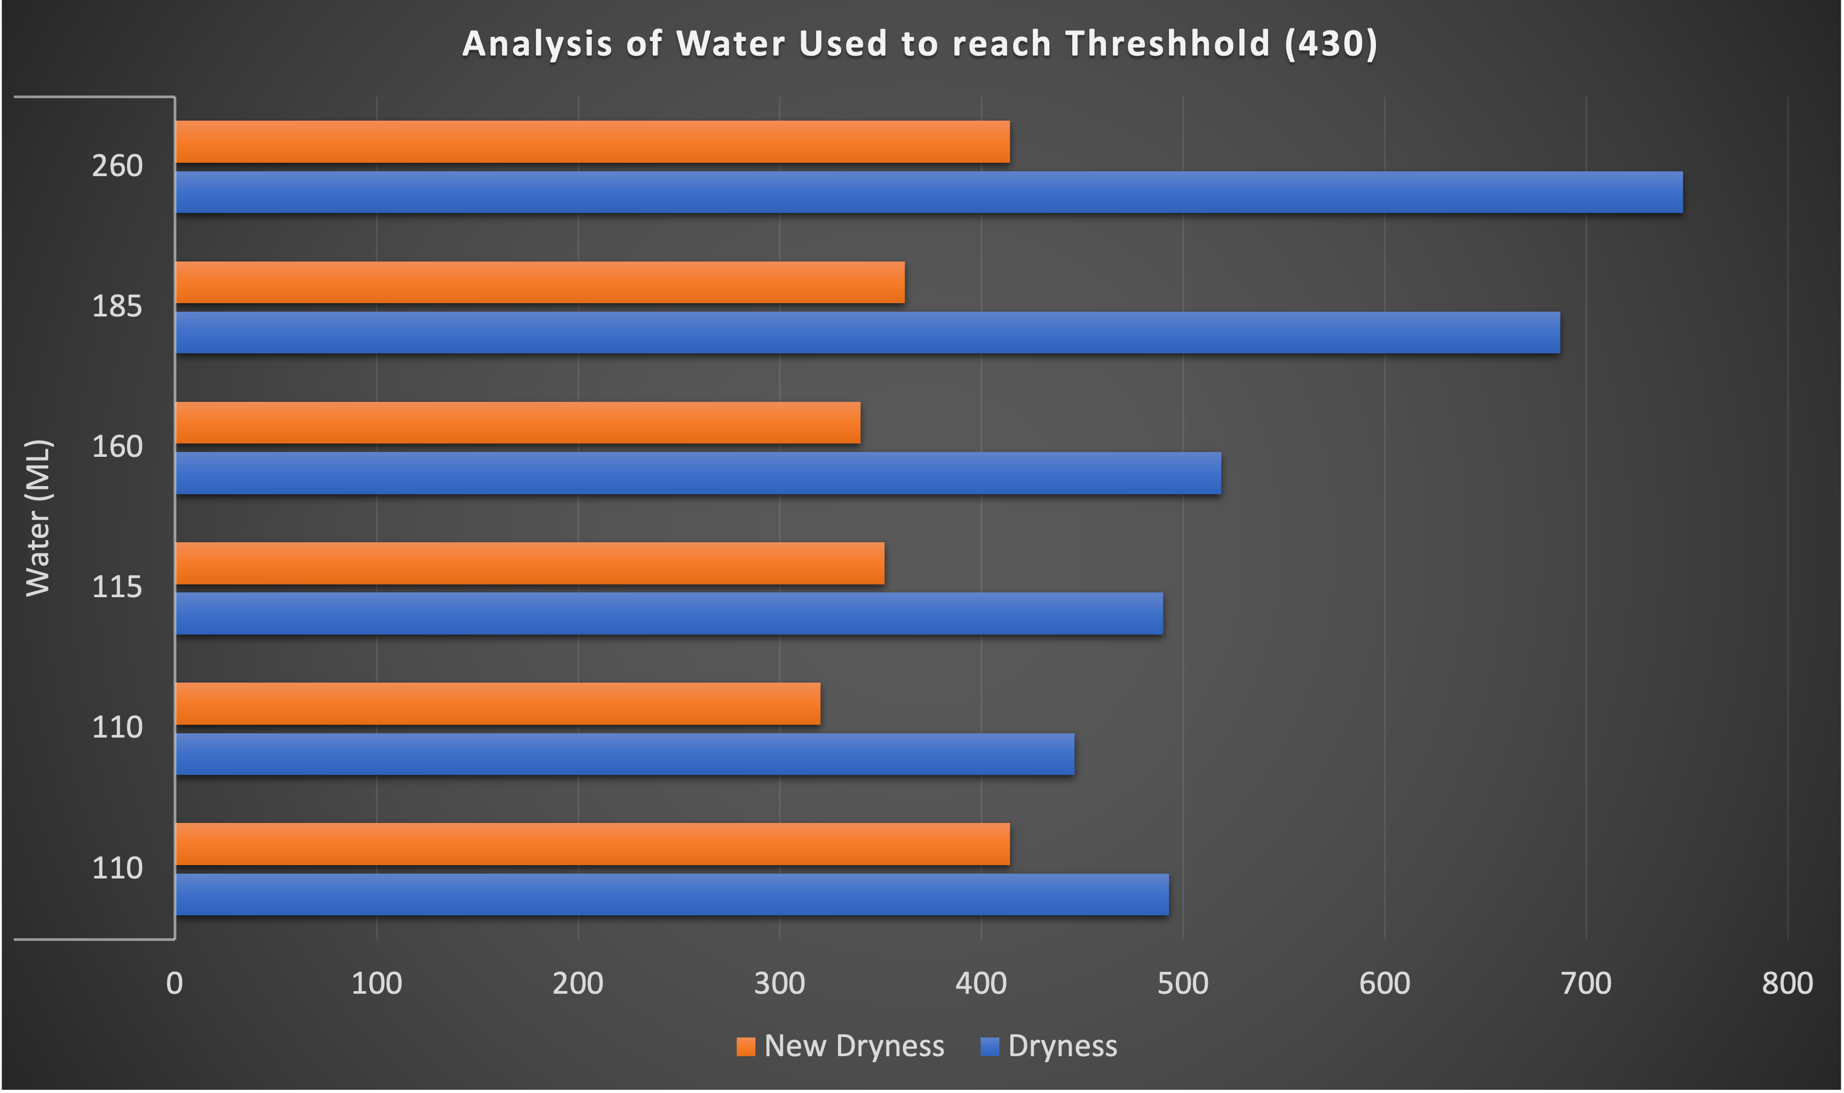
Evaluation
Trends in Irrigation process:
Reading of 6 small containers with dryness value between 450- 800
Wet soil threshold = 430
Water used by soil to reach the threshold level is captured in ML.

Slide 13
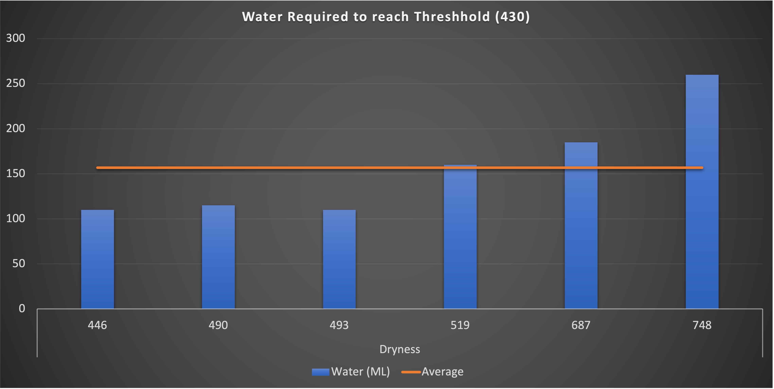
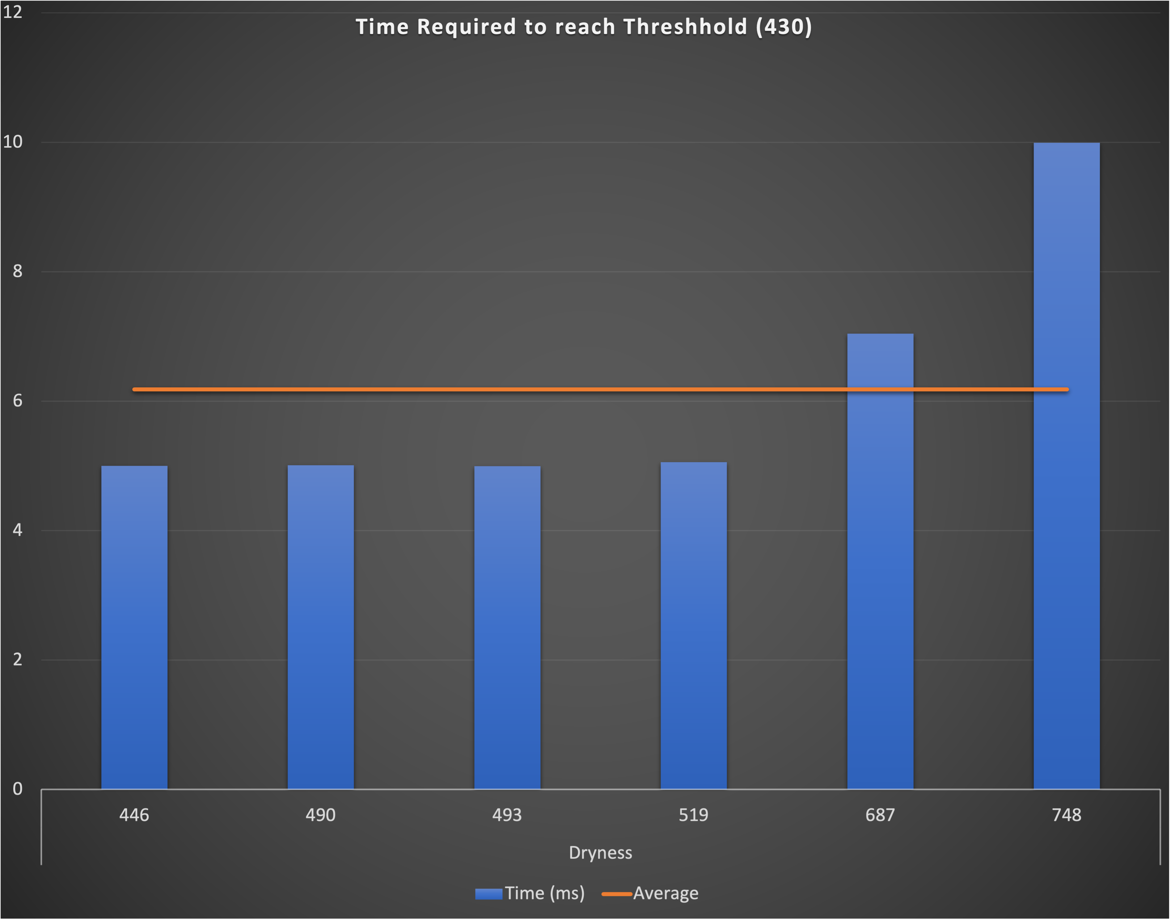
Evaluation
Average Water Used
Average Time Taken

Slide 14
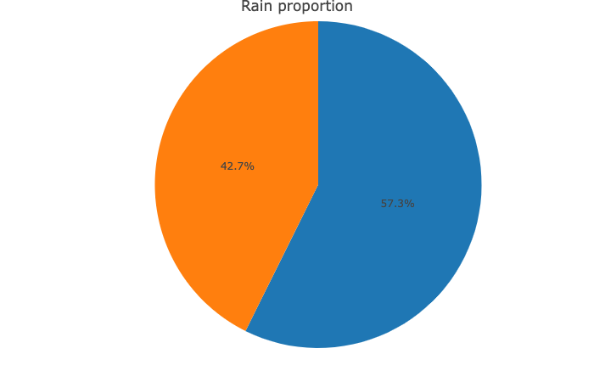
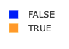
Project Impact & Future Scope
Impact:
Can save up to 20-25% water with advance weather forecast in the heavy rain areas.
Plan usage of water resources especially in the area of water scarcity with advance weather forecast technology.
Avoid death by overwatering for indoor plants 100% of the time.
Correctly predicts the need of watering, hence keeping plant healthy.
Flexibility to change the configurations and start/stop Irrigation process manually.
Future Scope:
Use of water level sensors and notify user when water level in tank is low.
Improve the accuracy in detecting the irrigation needs by considering the temperature and humidity around the plant.
Use machine learning to analyze the sensor data and recommend the idea threshold level as well as next Irrigation cycle by monitoring growth of plant.
Identify disease in plants using advance ML models and recommend the solutions.
Yearly Rain Proportion in Seattle Area

Slide 15
References
[1] W. Difallah, K. Benahmed, B. Draoui, and F. Bounaama, “Design of a solar powered smart irrigation system (SPSIS) using WSN as an IoT device,” ACM Int. Conf. Proceeding Ser., pp. 124–128, 2018, doi: 10.1145/3178461.3178482.
[2] R. J. Chakma, “An IoT based Energy Saving Automatic Watering System for Plants,” vol. 9, no. 5, pp. 42–48, 2021.
[3] M. Swapnali, B. Pawar, P. Rajput, and A. Shaikh, “Smart Irrigation System Using IOT And Raspberry Pi,” Int. Res. J. Eng. Technol., p. 1163, 2008, [Online]. Available: www.irjet.net.
[4] A. Gujar, R. Joshi, A. Patil, and P. S. Aranjo, “Indoor Plant Monitoring System using NodeMCU and Deep Learning,” pp. 1206–1212, 2020.
[5] C. Subramani et al., “IoT-Based Smart Irrigation System,” Adv. Intell. Syst. Comput., vol. 1040, no. 2, pp. 357–363, 2020, doi: 10.1007/978-981-15-1451-7_39.
[6] M. Riyadh Jabbar, “Simple Indoor Environmental Monitoring System for Houseplant using Web and Mobile Applications,” 2020.
[7] https://rstudio-pubs-static.s3.amazonaws.com/398946_828bb284a347469692235b1dd678ecea.html

Slide 16


